Slide 1

Sprocket Central Pty Ltd
Data analytics approach
[Division Name] - [Engagement Manager], [Senior Consultant], [SHELL TARI OFIYOU]

Slide 2
Note: The data and information in this document is reflective of a hypothetical situation and client. This document is to be used for KPMG Virtual Internship purposes only.
Agenda
Introduction
Data Exploration
Model Development
Interpretation

Slide 3
Introduction
PROBLEM STATEMENT
Sprocket Central Pty Ltd is a long-standing KPMG client that specializes in high-quality bikes and accessible cycling accessories to riders.
Their marketing team is looking to boost business by analyzing their existing customer dataset to determine customer trends and behavior.
Using the existing 3 datasets (Customer demographic, customer address and transactions). Please recommend which of these 1000 new customers should be targeted to drive the most value for the organization.

Slide 4
Data Exploration
Age Group with the most bike purchases.
Customers distribution from each state.
Bike purchase profits from job industries.
Profits from age distribution.
Profits from gender distribution.
Customer distribution base on gender.
RFM value segmentation.
RFM customer segments within value segment.
Comparison of RFM segments by customers.
Comparison of RFM segments based on recency, frequency, and monetary scores.

Slide 5
Data Exploration
Data quality issues identified in the Transaction, Customer Demographic and Customer Address databases.
DATASETS | ACCURACY | COMPLETENESS | RELAVANCY | VALIDITY | CONSISTENCY
Customer Demographic | Age column: Missing DOB column: Inaccurate | Job title column: Blanks | Default Column: Irrelevant |  | Gender column: Inconsistent
Transaction | Profit column: Missing | Online orders column: Blanks Brands: Blanks | Cancelled status column: Filtered out | List price column and product sold column: Format
Customer Address |  |  |  |  | States column: Inconsistent

Slide 6
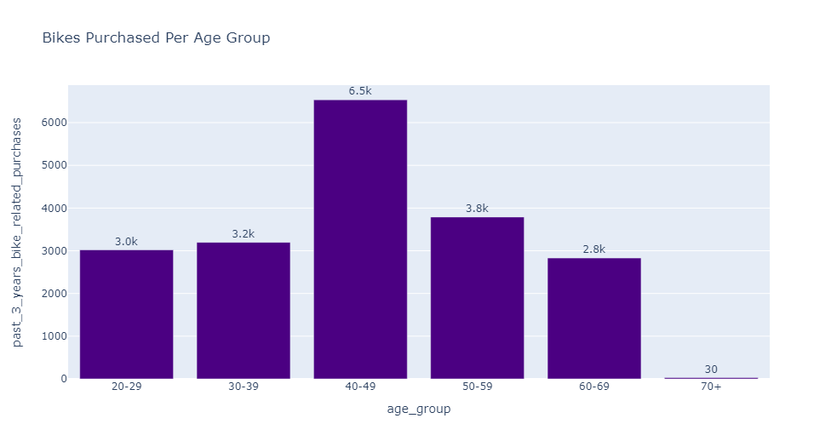
AGE GROUP WITH THE MOST BIKE PURCHASES
Highest bike's purchases for the last three years were from the age group of 40-49 with about 6.5k purchases, followed by the 50-59, 30-39, 20-29, and 60-69 age group with purchases of 3.4k, 3.2k, 3k and 2.8k, all roving around the 3k lane. The 70+ age group has the least purchase history with only 30 bikes for the last three years.

Slide 7
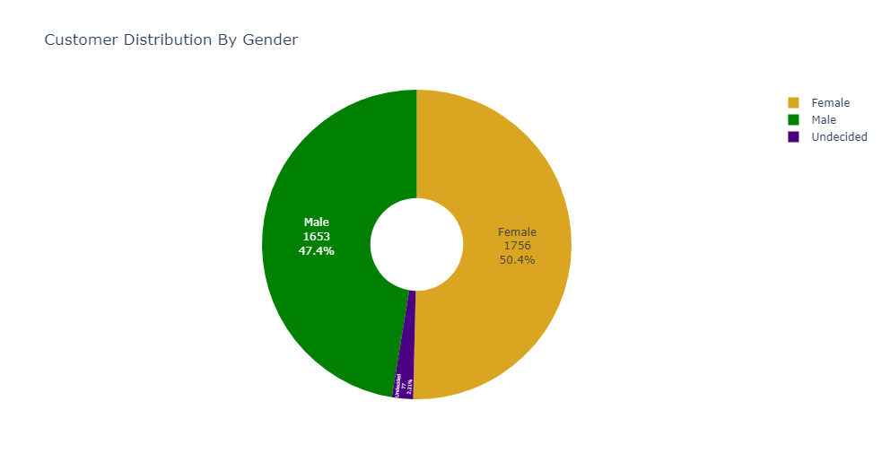
CUSTOMER DISTRIBUTION BASE ON GENDER
Majority of customers are female with about 1756 female customers accounting for 50.4% of the customers base, while male is 1653k male customers with 47.4% of the customer base and the undecided accounting for 2.21% with 77 undecided customers.

Slide 8
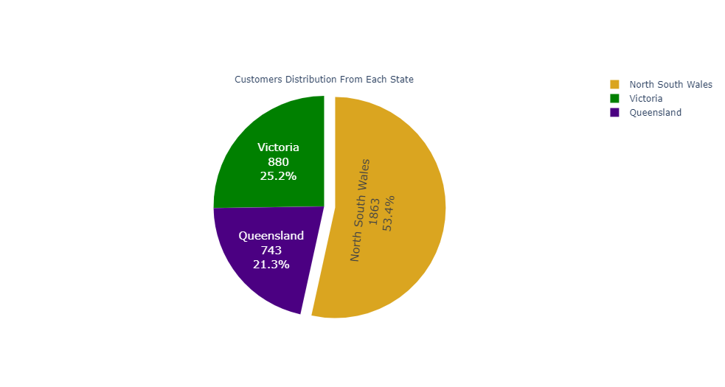
CUSTOMERS DISTRIBUTION FROM EACH STATE
Overall total customers is 3486. State with the highest customer base is North South Wales with 1863 customers accounting for 53.4% of the customer base, while state of Victoria has 880 customers accounting for 25.2% of the customers. Queensland is the state with the least customers, with about 743 customers accounting also for about 21.3% of the customer base.

Slide 9
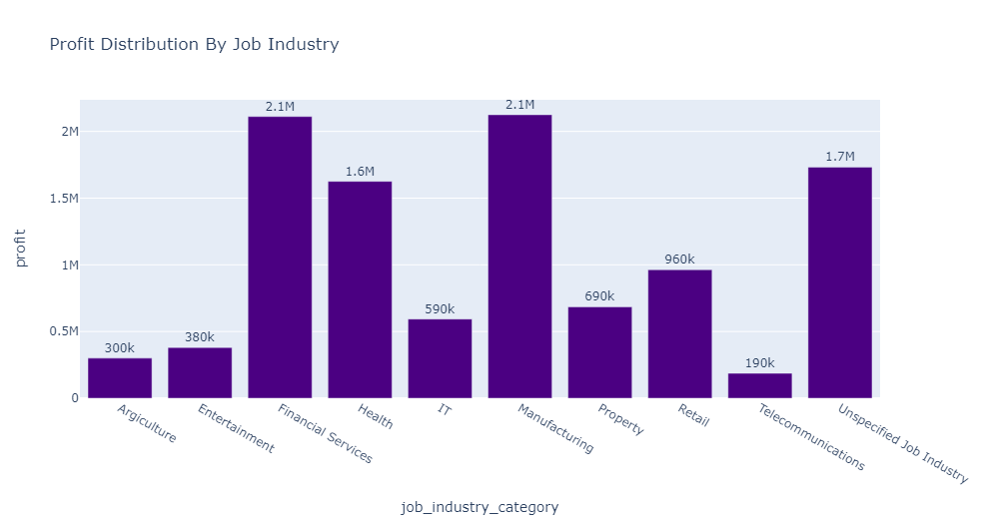
BIKE PURCHASES PROFIT FROM JOB INDUSTRIES
Highest profit comes from the Manufacturing and Financial Services job industry with profits of around 2.2m each, closely followed by profits from the Unspecified Job Industry and the health sector with about 1.7m and 1.6m. The least profit comes from the telecommunications industry with a profit of 190k.

Slide 10
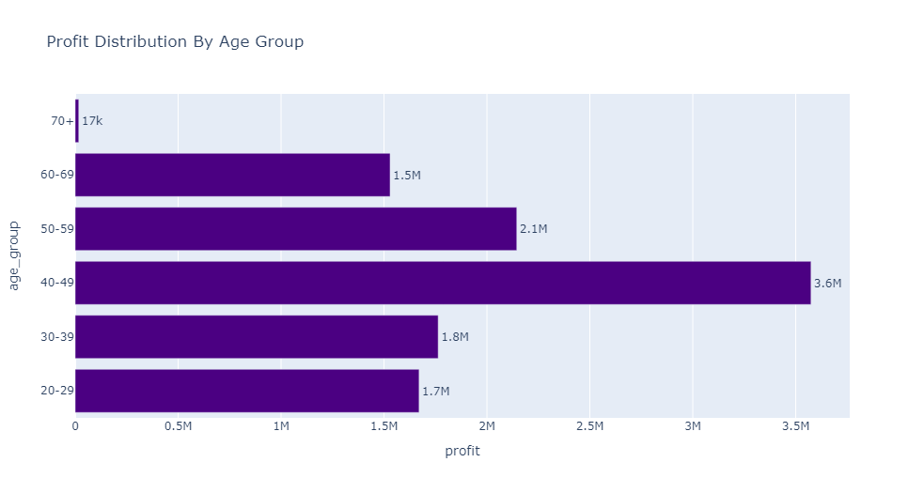
PROFIT FROM AGE DISTRIBUTION
Age group with the highest profit is the 40-49 age group with a profit of 3.7m, followed by the 50-59, 30-39, 20-29 and 60-69 with profits of 2.0m, 1.8m, 1.7m and 1.6m. Age group with the least profit is the 70+ age group.

Slide 11

PROFIT FROM GENDER DISTRIBUTION
Female customers contribute the highest profit compare to the male and the undecided gender with a profit of 5.5m accounting for 49.7% of overall profit, with the male and undecided with profitd of 5.3m and 280k each accounting for 47.8% and 2.51% respectively.

Slide 12
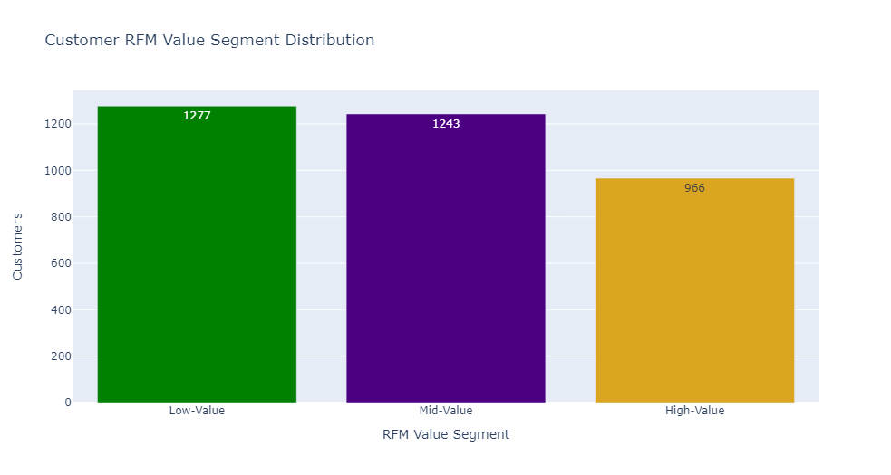
RFM VALUE SEGMENTATION
From the RFM value segment distribution gotten from the RFM SCORE, we have 1277k mid value customers, 1243k low value customer and 966k high value customers.

Slide 13
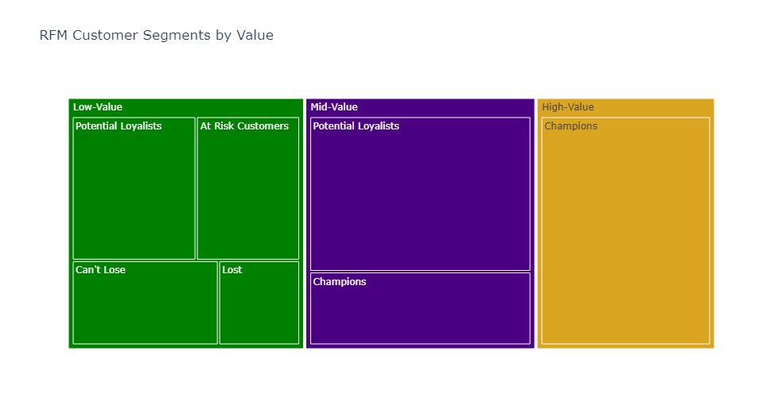
RFM CUSTOMER SEGMENTS WITHIN VALUE SEGMENT
In analyzing the distribution of customers across different RFM customer segments within each value segment. 844 potential loyalists customers and 399 champion customers falls at the mid value section and 438 potential loyalists, 366 at risk customers, 364 can't lose, and 169 lost customers falls at the low value section, while 966 champions customers falls at the high value section.

Slide 14
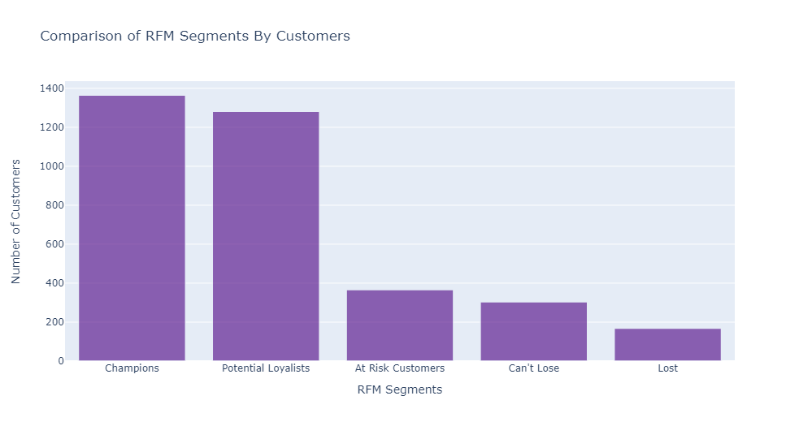
COMPARISON OF RFM SEGMENTS BY CUSTOMERS
In comparison of RFM segments base on total numbers of customers, we have the champions segment with 1365k customers, potential loyalists segment with 1282k customers, at risk segment with 366 customers, can't lose segment with 304 customers, and lost segment with 169 customers.

Slide 15
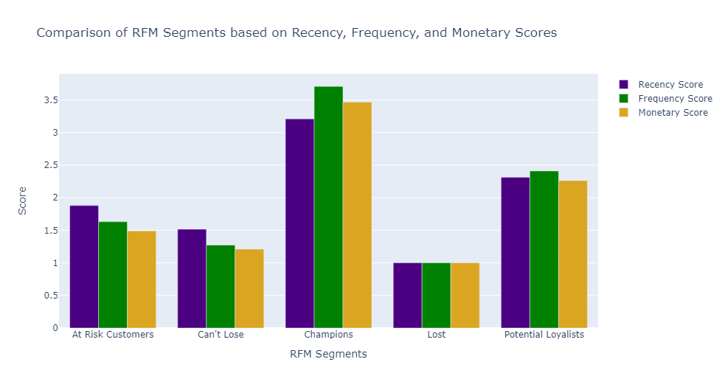
COMPARISON OF RFM SEGMENTS BASED ON RECENCY, FREQUENCY, AND MONETARY SCORES
In comparison of RFM Segments based on Recency, Frequency, and Monetary Scores, the champions segment scores are the highest, followed by potential loyalists segment. The least is the lost segment with low score count.

Slide 16
RECOMMENDATIONS
Base on insights from analysis from the old customers, the following recommendations were made concerning the new 1000 customers;
Customers from the age group of 40-49 and 50-59 should be more targeted as they tend to purchase more bikes, thereby contribute more to profit.
Customers from state of North South Wale and Victoria should be targeted as they have higher customers and higher profit contribution.
For the job industry, customers from the Manufacturing, Financial services, and Health sector should be targeted as profits from this sectors are high compare to the Telecommunication and Agriculture sectors which are low in profit.
Female and Male customers should be more targeted, most especially female as they are more in customers and hence contribute more profit.

Slide 17
Note: The data and information in this document is reflective of a hypothetical situation and client. This document is to be used for KPMG Virtual Internship purposes only.
Appendix

